Slide 1
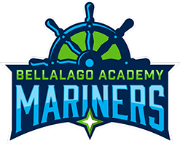
2022-23 Schoolwide Improvement Plan Overview
Bellalago Charter Academy
Notes:
Good morning and thank you for attending today’s training on the 2020-21 Schoolwide Improvement Plan, otherwise known as the SIP.
Attendance will be tracked during this training through TEAMs!!

Slide 2

A dream can come true if you believe and work together!!!

Slide 3

Purpose of the SIP
The purpose of the SIP is to assist school leadership teams in the development of a plan to identify and address needs and action steps required to increase student achievement.
This is achieved by analyzing multiple data sources, many of which are embedded within the SIP.
Notes:
The purpose of the SIP is to assist school leadership teams in the development of a plan to identify and address needs and action steps required to improve student outcomes. But we must not forget the monitoring of these actions!
This is achieved by analyzing multiple data sources, many of which are embedded within the SIP and others which you should have from formative assessment data and data REA department has given you last year, and not forgetting previous climate survey data, Insight survey data, and panorama SEL survey data.

Slide 4
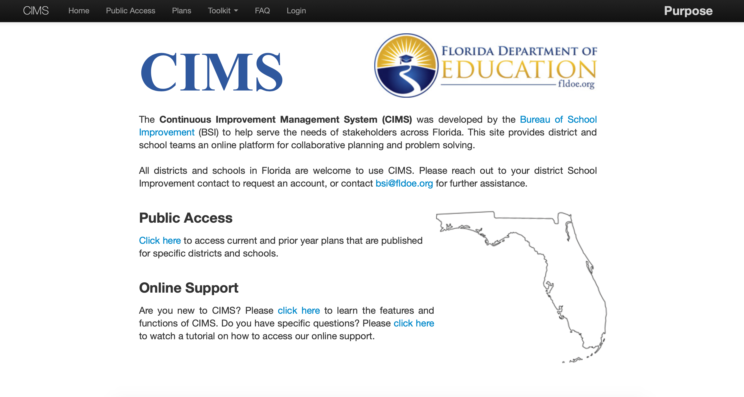
Florida Continuous Improvement Model
The Schoolwide Improvement Plan (SIP)
www.floridacims.org
Notes:
You can access our SIP at the Bureau of School Improvement’s platform—CIMS—located at www.floridacims.org

Slide 5

SIP
Walkthrough
Notes:
I will now walkthrough and show you how to navigate the 2020-21 SIP.
A few of the revisions you will see include:
Additional data in the demographic section, including identifying the number of teachers with a 3-year aggregate or 1-year Algebra state VAM score of Highly Effective or Effective.
Multiple updates to the Planning for Improvement section, which include the Areas of Focus , specific subgroups, individualized Action Steps, and the addition of a Positive Culture and Environment section.

Slide 6
Part I: Mission and Vision
School Mission Statement
Our Mission at Bellalago Academy is to achieve lifelong learning by exploring education that is anchored in excellence.
School Vision Statement
We, the Mariners of Bellalago Academy, will accomplish our mission by creating a challenging learning environment, fostering mutual respect, honoring diversity, and establishing a safe, nurturing community.

Slide 7
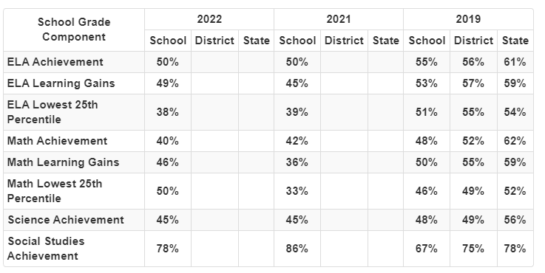
Part II: Needs Assessment

Slide 8
Part III: Areas of Focus 2022-2023
Area of Focus – Instructional Practice: ELA
Area of Focus – Instructional Practice: Math
Area of Focus – Instructional Practice: Science
Area of Focus – Instructional Practice:
Professional Learning Communities
Area of Focus – Positive Culture and Environment

Slide 9
Part III: Area of Focus Guiding Questions
What is your end goal or desired future state?
What will you accomplish?
What is the desired timeline?
Goals should be SMART:
Specific, Measurable, Achievable, and Relevant

Slide 10
Goals for ELA, Math, and Science
ELA
Based on the 2022 school data, ELA proficiency was 50%, learning gains was 49% and learning gains for the lowest 25% was 38%.
The outcome goal for the 2022-23 school year is to increase ELA proficiency by 10% to 60% and increase learning gains to 50% in all subgroups.
Math
Based on the 2022 school data, Math proficiency was 40%, learning gains were 46% and the lowest quartile increased to 50%.
The outcome goals for the 2022-23 school year is to increase proficiency and gains by 10% for all groups.
Science
Based on the 2022 school data, Science proficiency was 45%.
The outcome goals for the 2022-23 school year is to increase proficiency by 10%.

Slide 11
Professional Learning Communities
Professional Learning Communities is defined as “…an ongoing process in which educators work collaboratively in recurring cycles of collective inquiry and action research to achieve better results for the students they serve” (DuFour, 2006).
Set clear objectives that are focused on student learning. The PLC model is grounded in the assumption that building teachers’ competencies will lead to improved academic, behavioral, or social outcomes for students. Consequently, student learning is both the foundation and evidence of an effective PLC.

Slide 12

Positive School Culture
Well-implemented programs designed to foster positive outcomes have been found to generate, better test scores and higher graduation rates, and improved social behavior. These competencies include skills, such as the ability to collaborate and make responsible decisions; mindsets, thinking positively about how to handle challenges; and good habits.
A positive school climate includes a safe environment, strong student and staff relationships, and supports for learning. It provides the foundation that students need, to develop a positive culture they need to succeed in life.

Slide 13
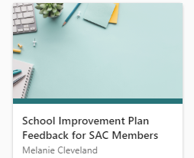
SIP Feedback Form

